Slide 1
Judiciary Management
DBMS (CS254) Mini Project

Slide 2
Modules of the Web Application
Chief Justice (Admin) Selection and appointment of judges. • Add/Modify laws to the constitution All the services included in the Judges module | Judges Update/ Modify the case records and details. File new cases brought to their respective courts. View unscheduled, scheduled, pending and past cases. Schedule cases to be held in the court. View Court Schedule.
Lawyers Accept / Reject clients. Access(read only) case records. View Court Schedule. | Clients Find lawyers to represent them for respective cases. Access(read only) case records. View Court Schedule.

Slide 3
Implementation Details
Software used for Front-End Interface:
HTML
JavaScript
Cascading Style Sheets (CSS)
Software used for Back-End Interface:
PHP
MySQL
GitHub Repository :
https://github.com/ajay-vikram/INDIAN-JUDICIARY.github.io.git -

Slide 4

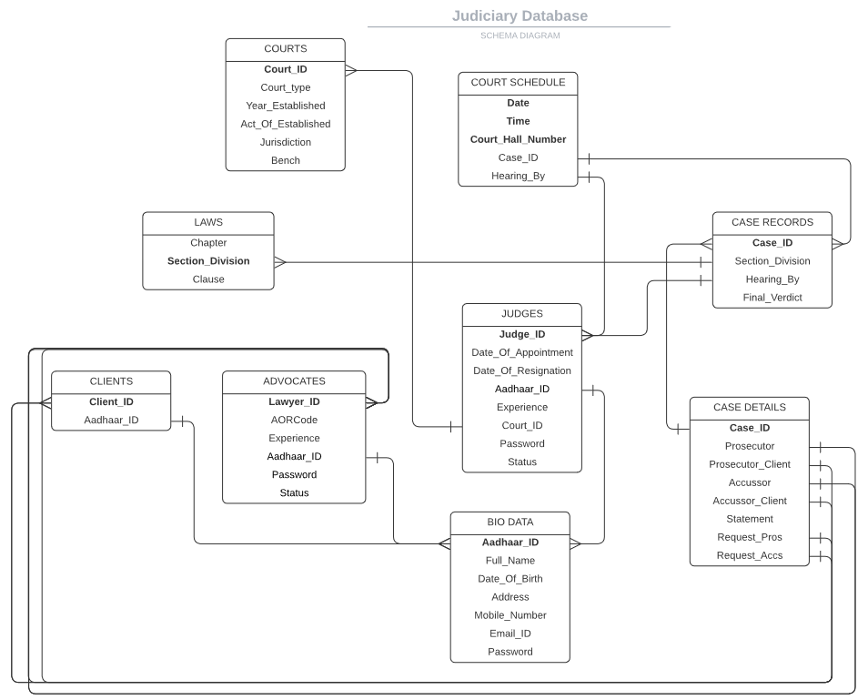
Schema Diagram

Slide 5
Web Application Screenshots

Slide 6
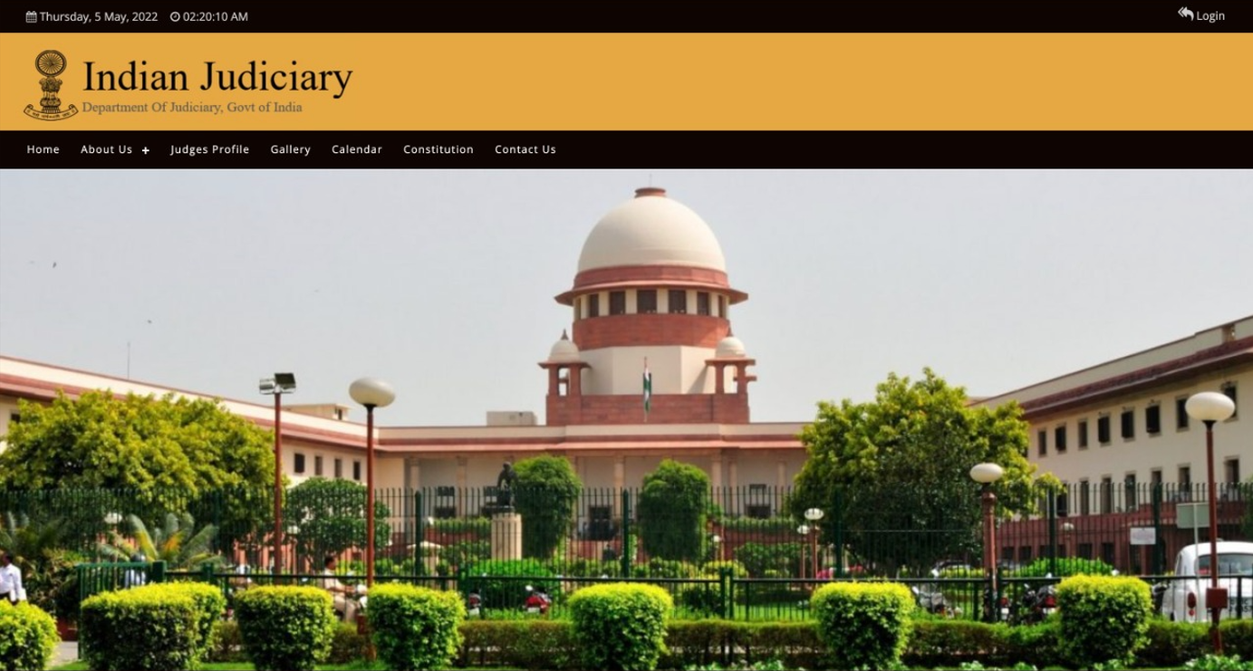
Home Page

Slide 7
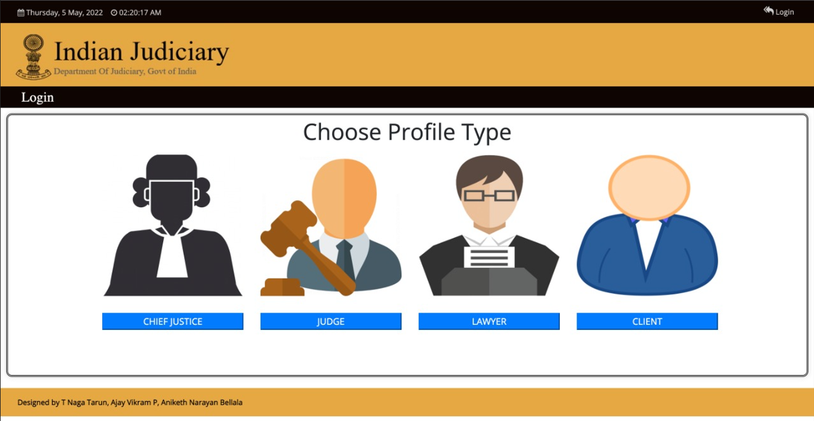
Login Page

Slide 8
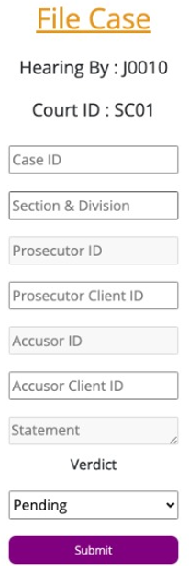
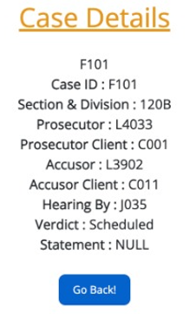
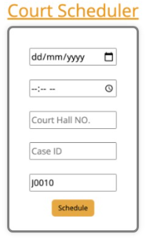
Functionalities

Slide 9
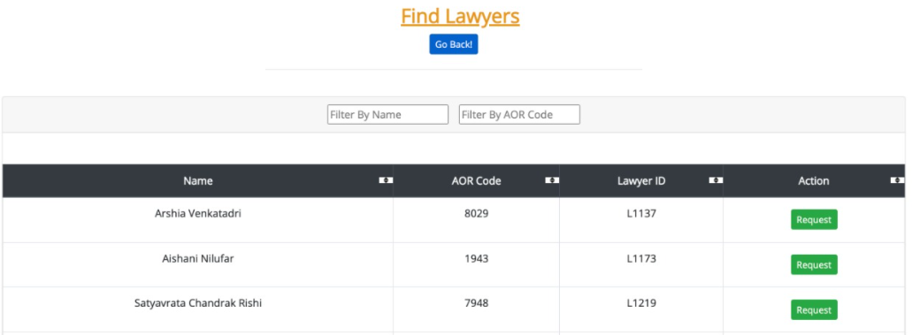
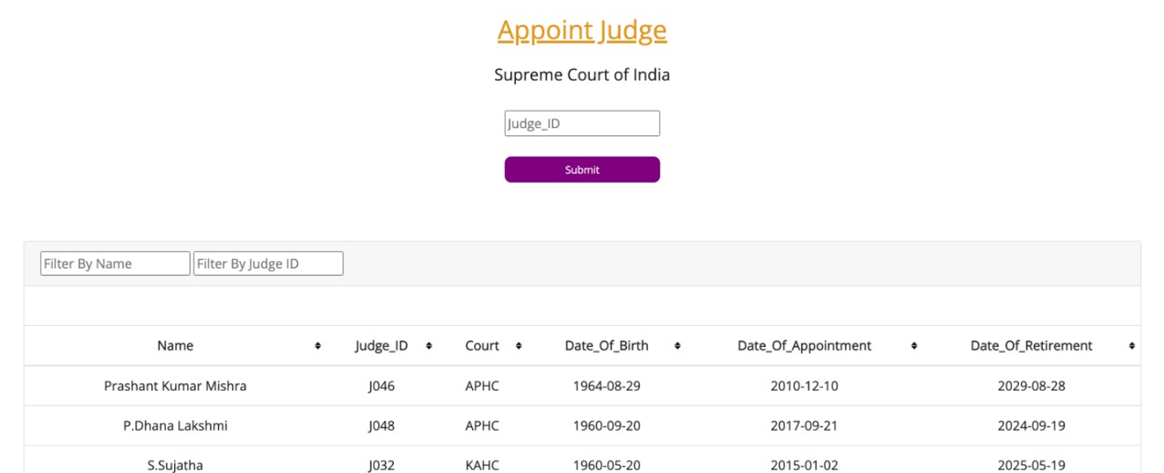
Services:
- Find Lawyers
- Appointment
of judges

Slide 10
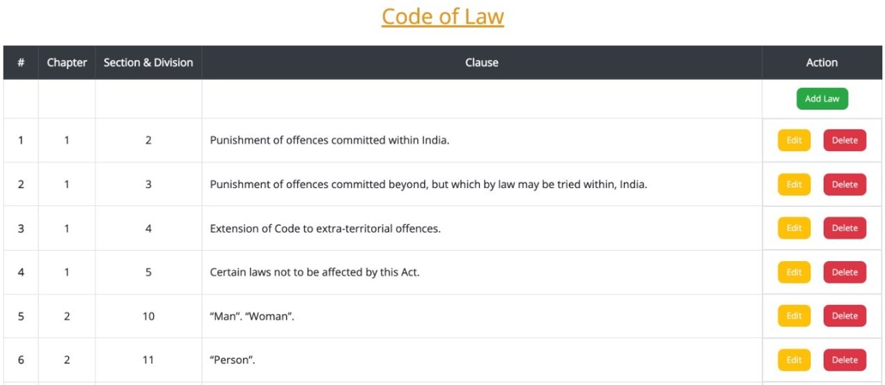
Laws

Slide 11
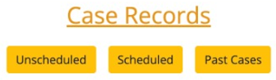
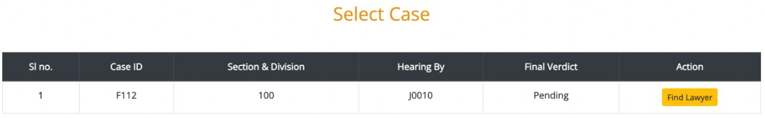
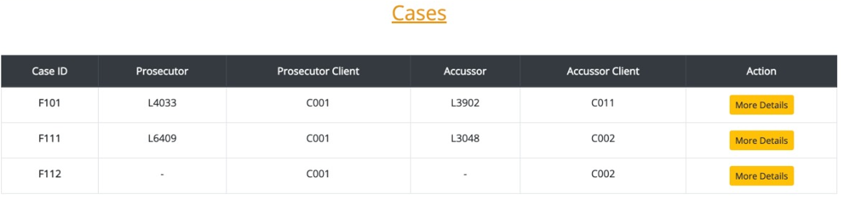
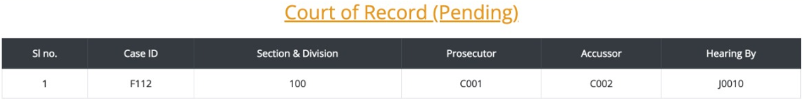
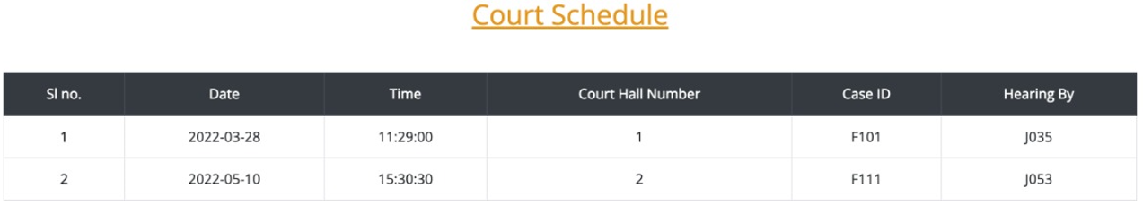
Records:
- Case Details
- Court Schedule

Slide 12
Thank YOU!
Project done by:
Aniketh Narayan Bellala – 201CS108
Ajay Vikram P – 201CS204
T Naga Tarun – 201CS261

